Slide 1
Lesson 3.3.2
How can I change it to y=mx+b form?
Literal Equations and Formulas

Slide 2
WARM-UP #1

Slide 3
WARM-UP #2

Slide 4
What is a literal equation?

Slide 5
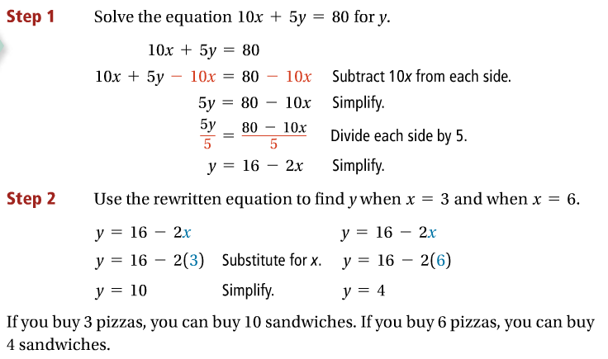
Problem 1 – Rewriting a literal equation

Slide 6
Got it?

Slide 7
Problem 2 – Rewriting a literal equation with only variables

Slide 8
Got it?

Slide 9
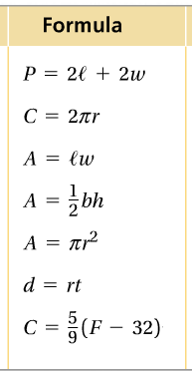
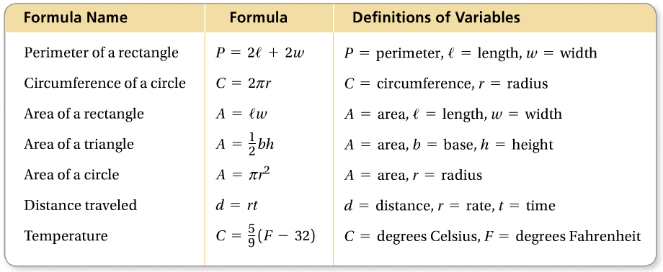
Name the formulas!

Slide 10
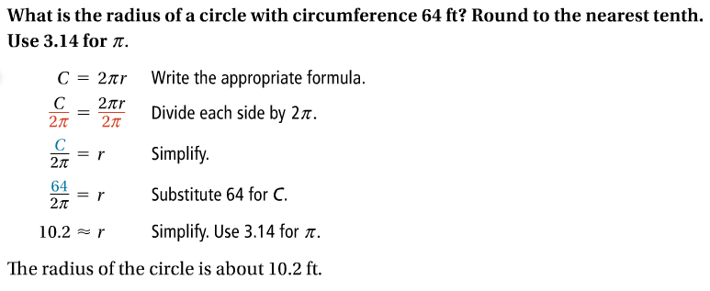
Problem 3 – Rewriting a geometric formula

Slide 11
Got it?

Slide 12
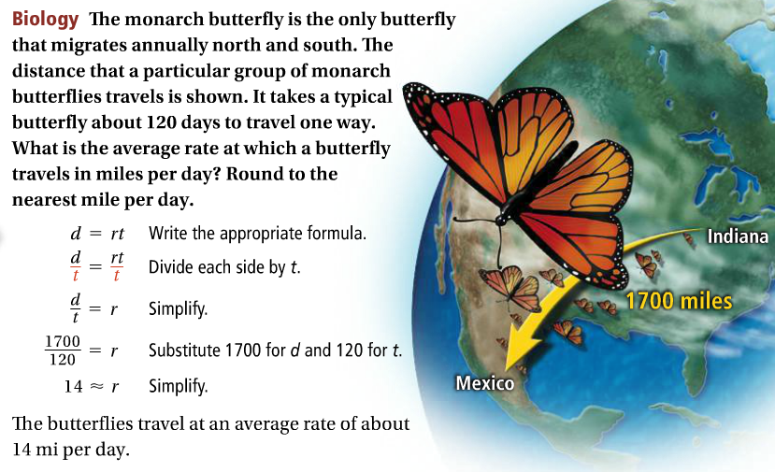
Problem 3 – Rewriting a formula

Slide 13
Got it?

Slide 14
Work with your group members to complete Section 3-89 on page 123 in your textbook. Write your answers in your math notebook.

